Slide 1
Mapping the Educational Landscape: A Comprehensive Data Analytics Study of Engineering Colleges in India

Slide 2
PROJECT OBJECTIVE
India has a large number of engineering colleges spread across different states, offering various courses. However, scattered data on college locations, fees, and infrastructure makes it hard for students, parents, and policymakers to make informed choices. This project uses data analysis to study course availability, fee structures, and infrastructure quality. It compares government and private colleges, highlights regional differences, and examines enrolment trends. The goal is to improve access, affordability, and decision-making in higher education.

Slide 3
MAIN AGENDA
Web Scrapping to collect the data
Data Cleaning and Manipulation
Visualization and Analysis on various factors like Fee, Location, infrastructure, collage type….etc.…. to analyze above problem statements.
An in-depth exploration of web scraping and data visualization using Python on the “getmyuni.com” website to extract engineering college data across India. Learn the power of data extraction and visualization for insightful analysis of college distribution, courses, fees, and infrastructure.

Slide 4
INTRODUCTION
Overview of Project:
Discover the main objectives and scope of the Mapping the Educational Landscape project, including web scraping, data cleaning, data modeling, and preprocessing in Python, along with data visualization in Tableau.
Importance of Analyzing Educational Data:
Analyzing engineering college data is crucial for understanding college distribution, fee structures, course availability, and infrastructure, helping students, parents, and policymakers make informed decisions.
Importance of Web Scraping, Data Preprocessing, and Visualization:
Explore why web scraping, data preprocessing, and data visualization are essential for collecting, structuring, and analyzing educational data, enabling insightful decision-making in higher education.

Slide 5
TOOLS USED
Software Requirement:-
Python(Jupyter notebook)
Powerbi
Excel
Main Software Libraries:-
Pandas
Numpy
Beautiful Soups
Requests
CSV

Slide 6
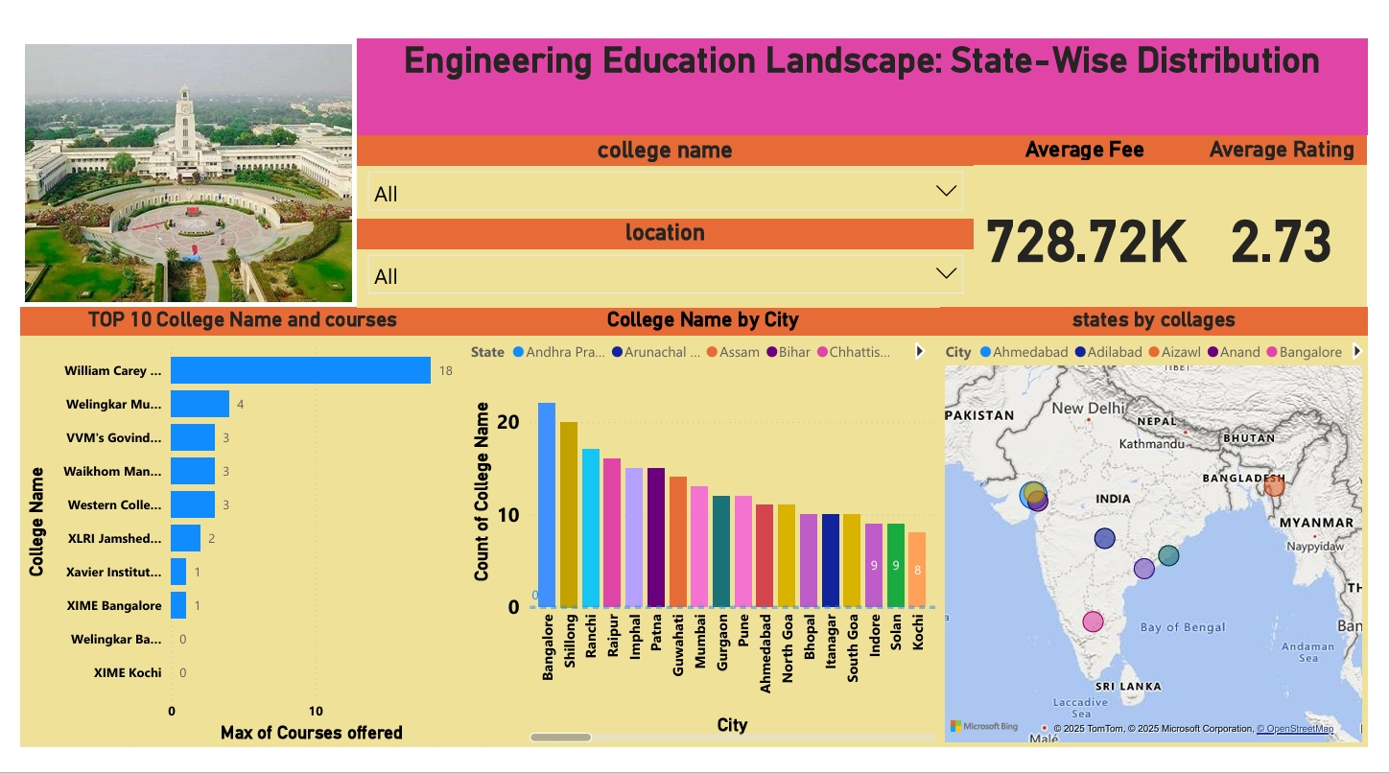
DASHBOARD’S

Slide 7
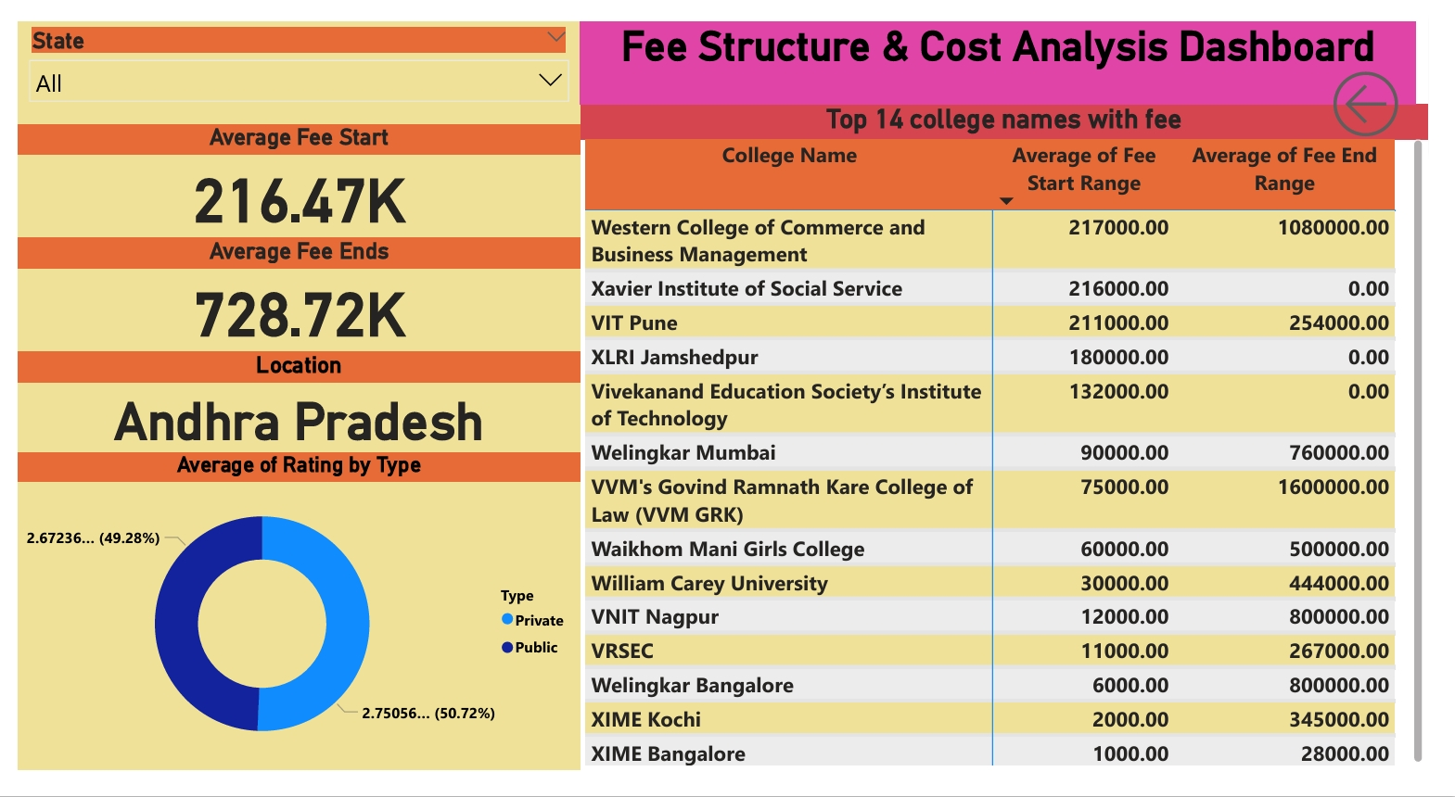

Slide 8
KEY INSIGHTS
College Distribution:
Bangalore has the most engineering colleges, followed by Shillong, Ranchi, and Imphal.
Other major hubs include Mumbai, Pune, Ahmedabad, and Bhopal.
Courses Offered:
William Carey University offers the most courses (18), followed by Welingkar Mumbai (4).
Many colleges offer around three courses each.
Fee Structure:
The average tuition fee is ₹728.72K, with fees ranging from ₹216.47K to ₹1.6M.
William Carey University has one of the lowest fees (₹30,000), while some institutions charge much higher.
College Ratings:
The average college rating is 2.73 out of 5.
Public colleges have slightly better ratings (2.75) than private ones (2.67).

Slide 9
THANK YOU

